Slide 1
ICS 第十三次小班课
小班教师：金芝老师
助教：龚晨

Slide 2
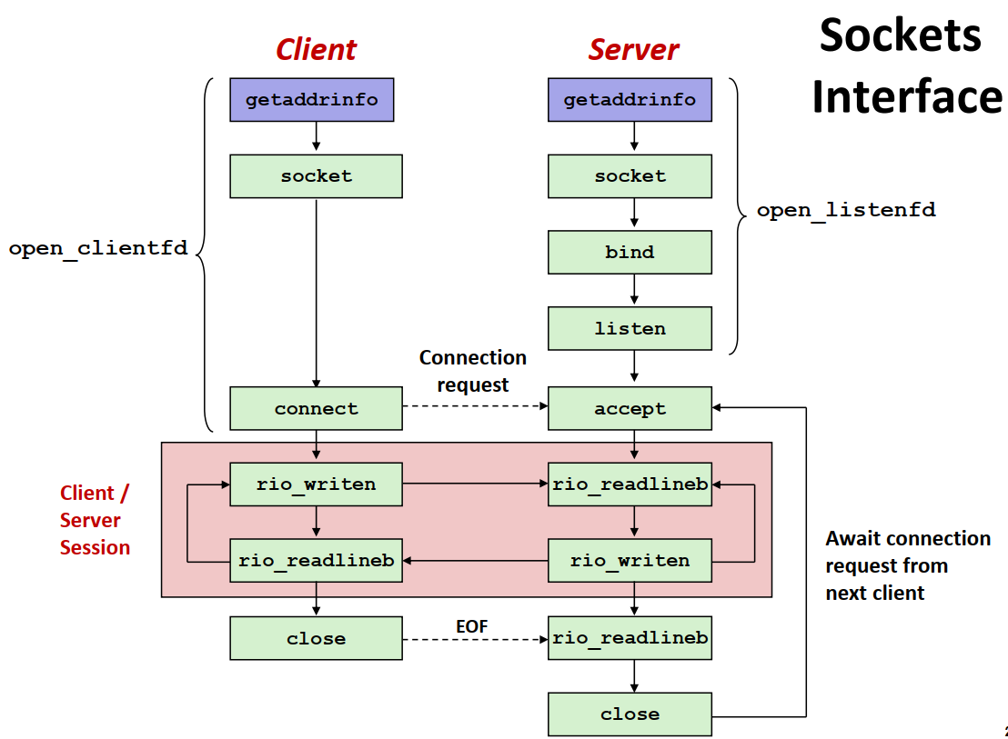
socket
哪些调用是阻塞的？

Slide 3
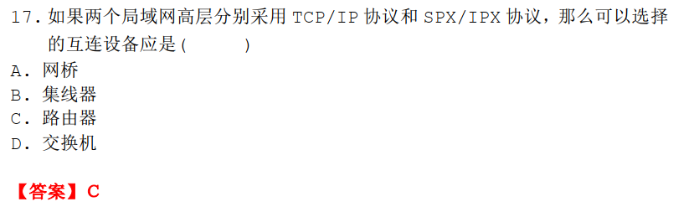
2014年期末
TCP/IP协议同SPX/IPX协议都是协议栈，各自都包含了一组协议。而月它们都可以实现路由的功能，在不同的局域网之间进行通信，是可以选择的协议。如果互连的局域网高层分别采用TCP/IP协议与SPX/IPX协议，那么我们可以选择的多个网络互联设备应该是路由器。

Slide 4
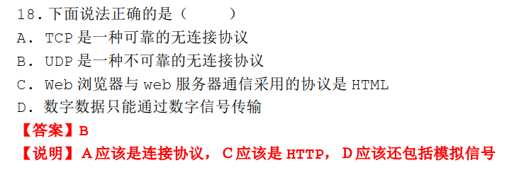
2014年期末

Slide 5
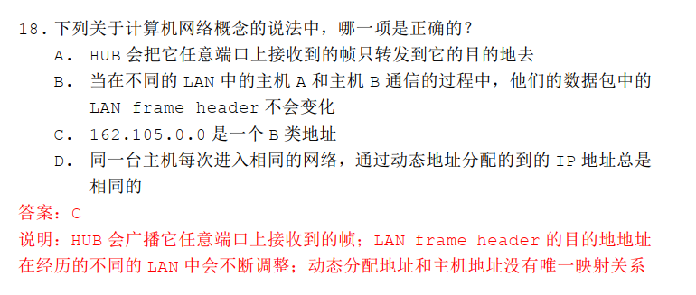
2015期末

Slide 6
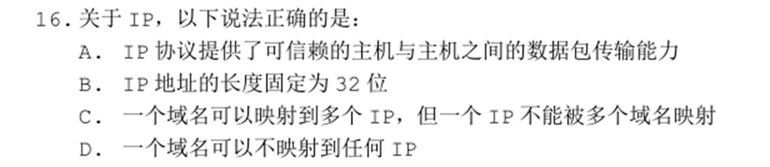
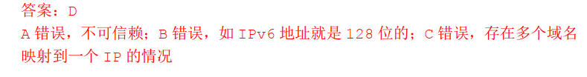
2016年期末

Slide 7
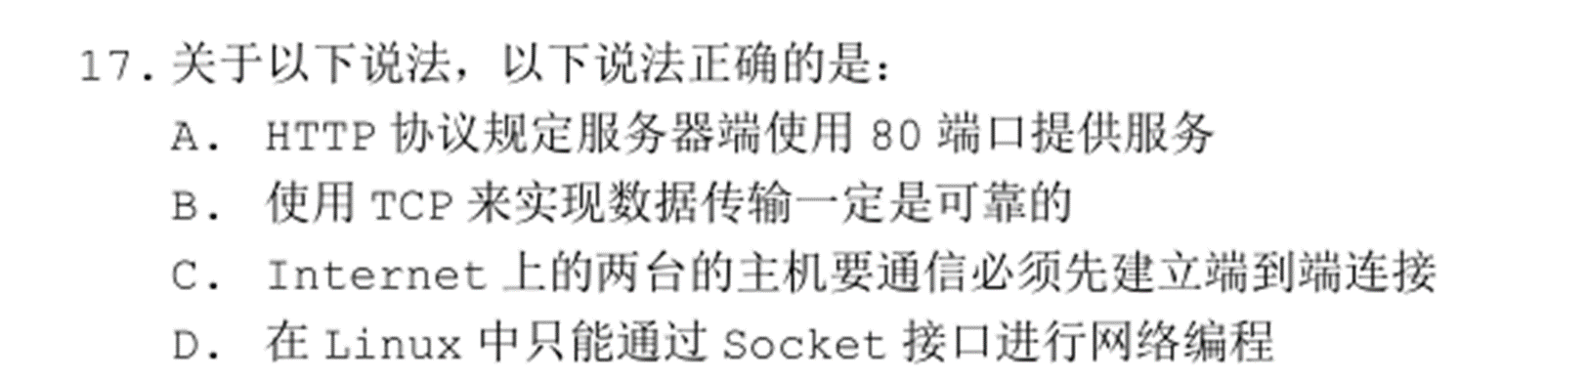
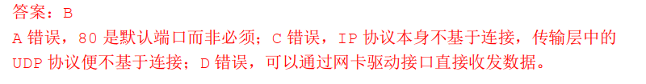
2016年期末

Slide 8
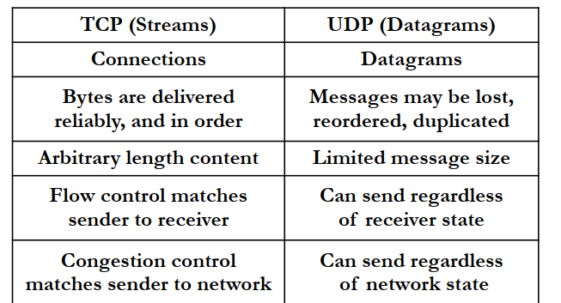
TCP&UDP

Slide 9
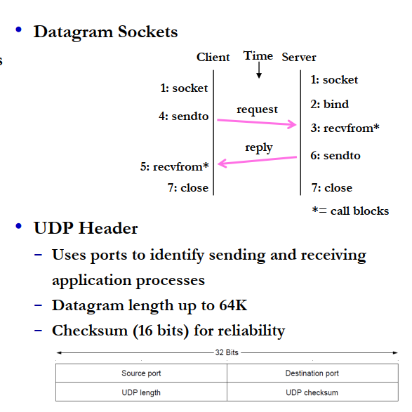

Slide 10
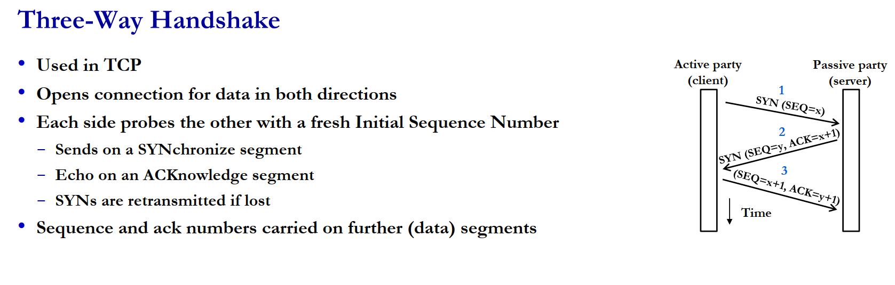

Slide 11
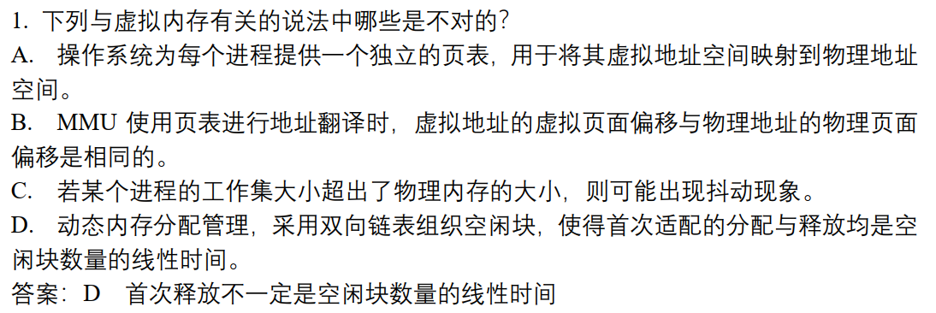

Slide 12
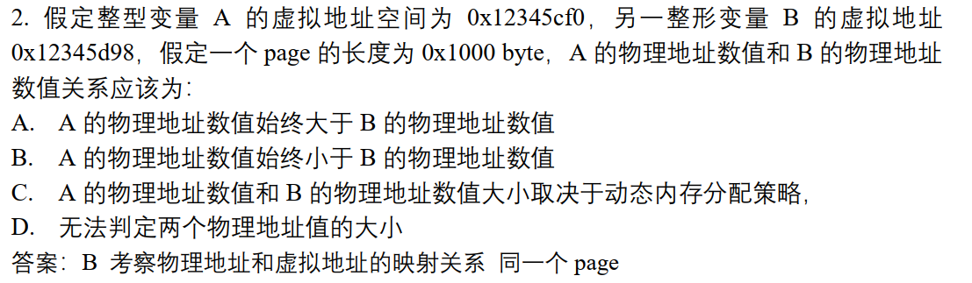
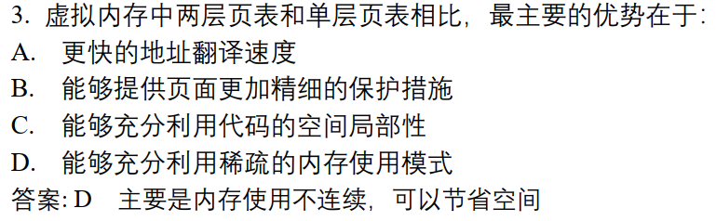

Slide 13
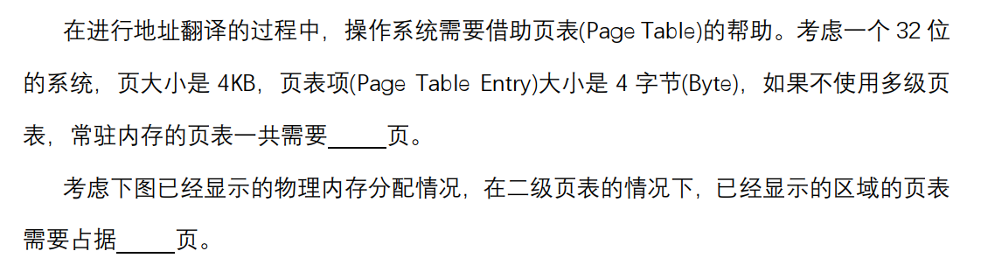
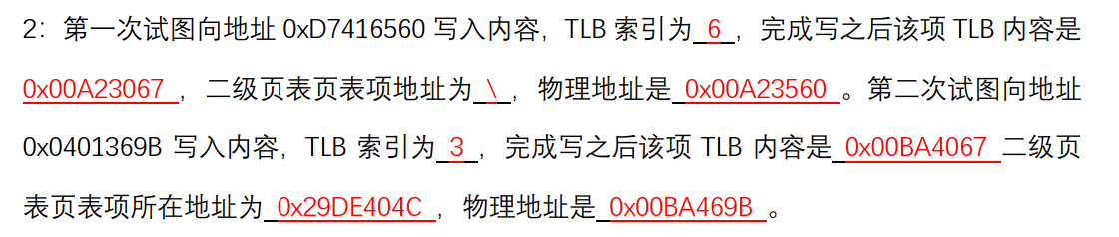
1024
5

Slide 14
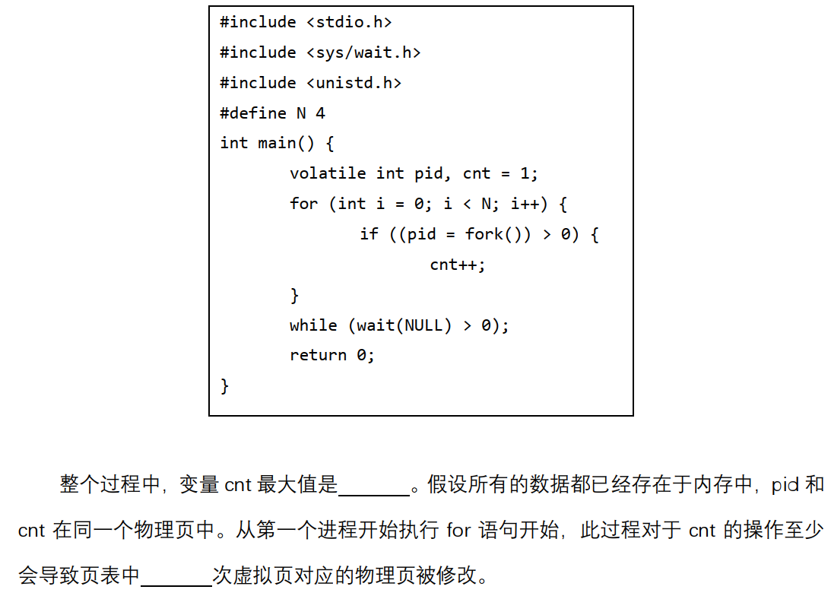
5
15

Slide 15
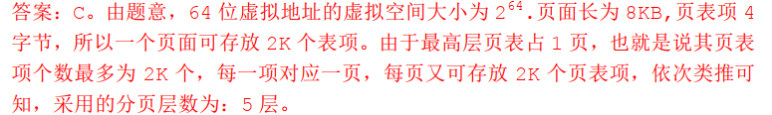
2015年期末

Slide 16
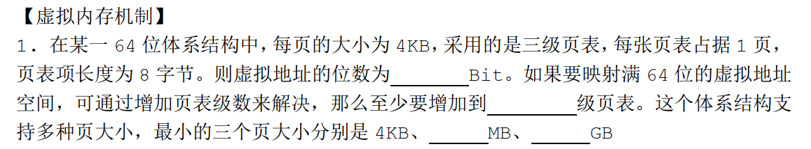
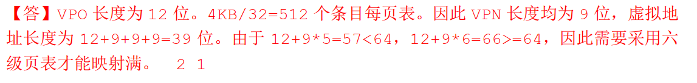
39
6
2
1

Slide 17
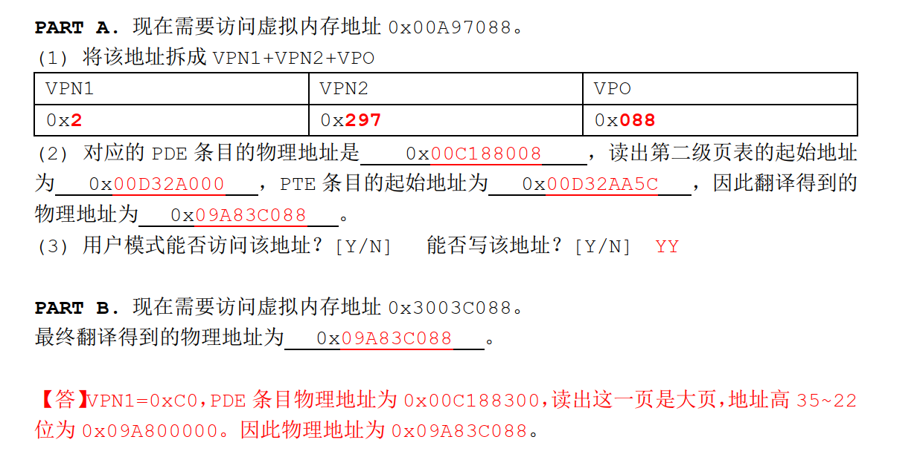

Slide 18
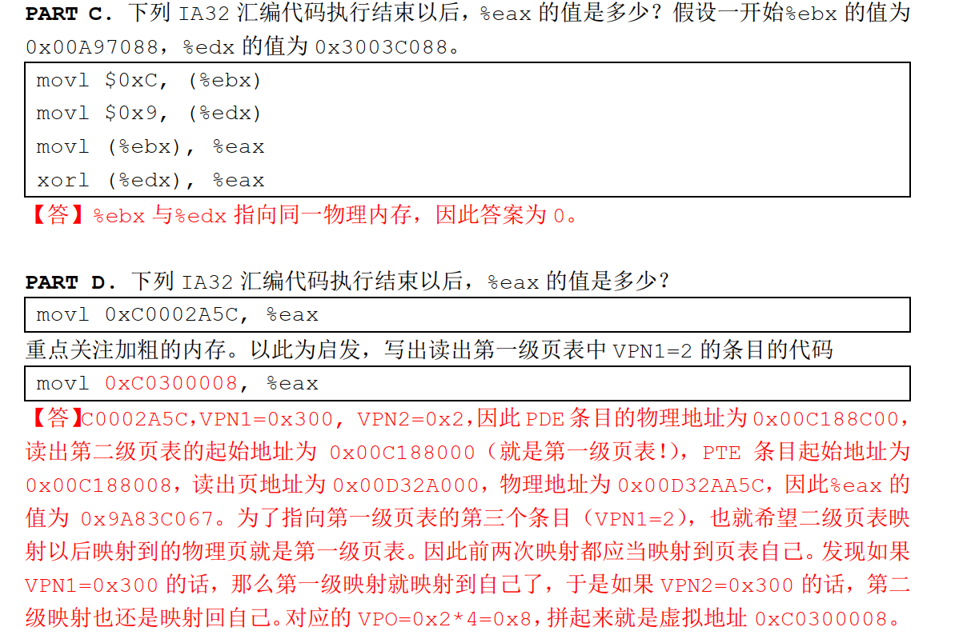

Slide 19
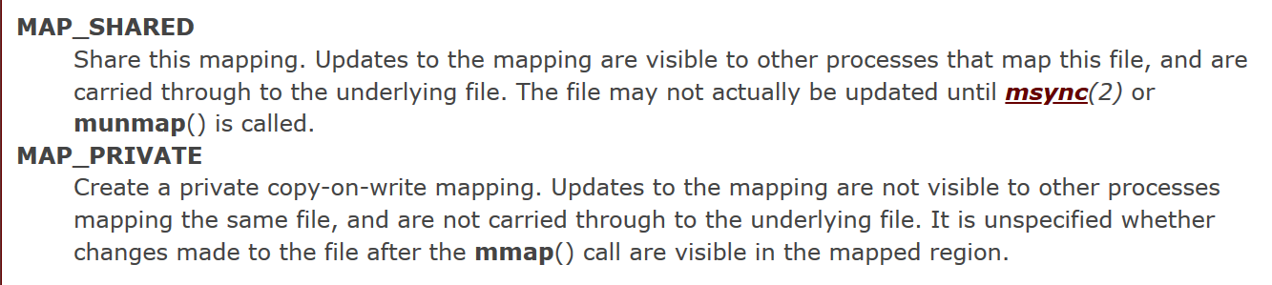
mmap
同一个文件：同样的物理页

Slide 20
Private file mapping
The contents of the mapping is initialized from file by reading the corresponding file region
Subsequent modifications are handled via copy-on-write
They are invisible to other processes
They are not saved to the backing file
应用场景：
Dynamic loader/linker

Slide 21
Shared file mapping
Processes mapping the same region of a file share physical memory frames
The involved physical frames have the mapped file as ultimate backing store
Modifications to the shared physical frames are saved to the mapped file on disk

Slide 22
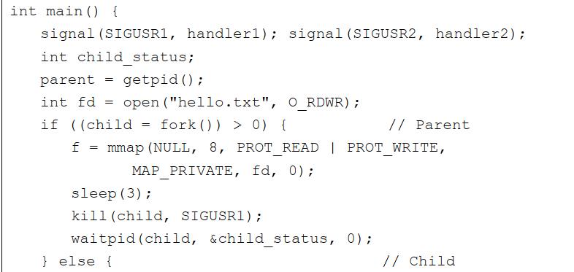

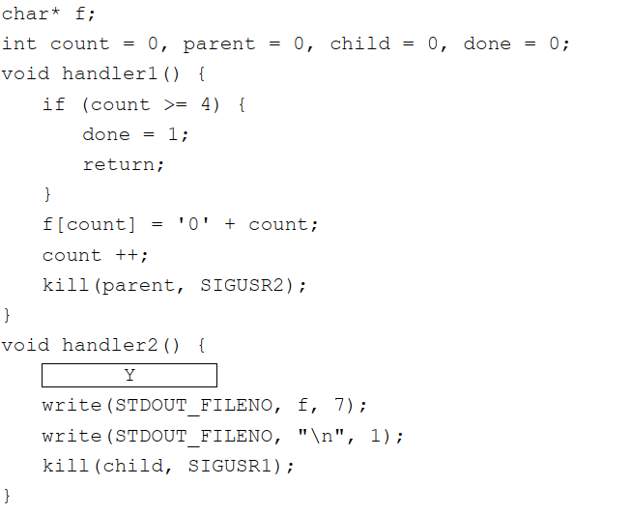
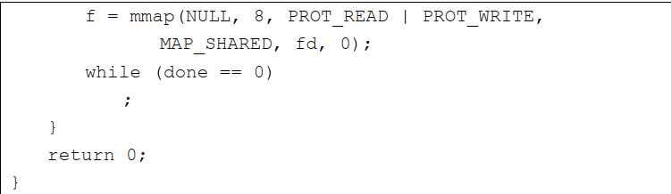
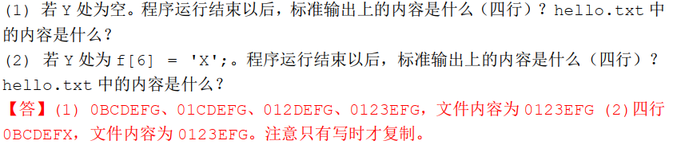

Slide 23
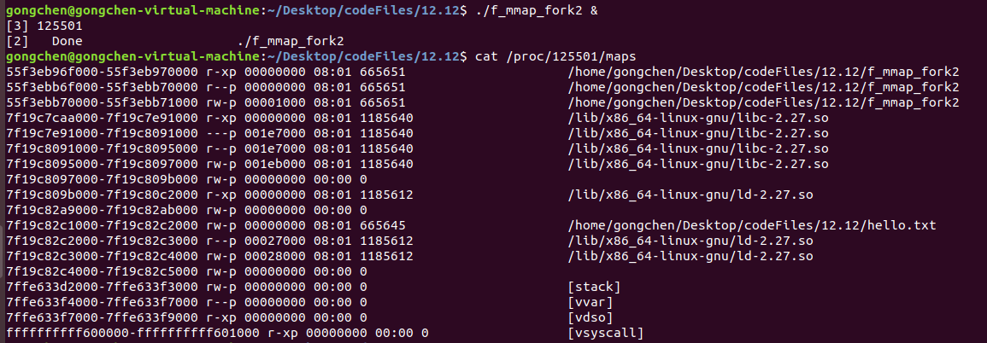
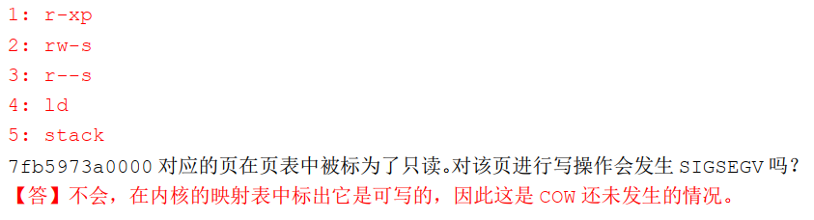
https://blog.csdn.net/unix21/article/details/8450042

